Slide 1
Privacy-Preserving Data Publishing
Data Security Series Topic 3
YAN, Da
yanda@uab.edu
Department of Computer Science
The University of Alabama at Birmingham (UAB)

Slide 2
Big Data Privacy
Big data is mostly collected from individuals
Individuals want privacy for their data
How can entities use such sensitive data?
Anonymize it ! but how ?

Slide 3
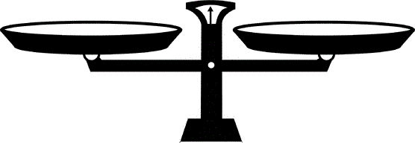
Tradeoff: Privacy v.s. Utility
A privacy notion for privacy protection guarantee
Design a mechanism under such notion with high utility
Privacy
Utility

Slide 4
GIC Incidence [Sweeny 1998]
Group Insurance Commissions (GIC, Massachusetts)
Collected patient data for ~135,000 state employees.
Gave to researchers and sold to industry.
Medical record of the former state governor is identified.

Slide 5
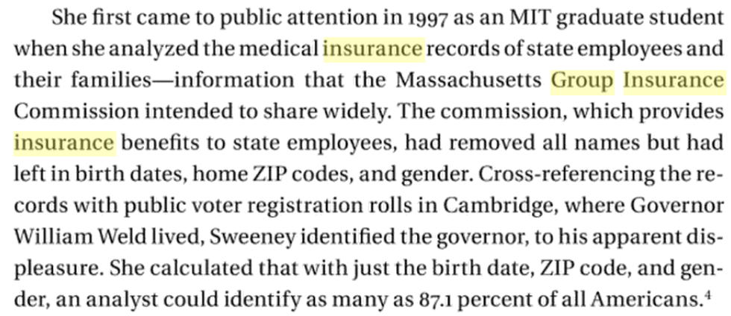
GIC Incidence [Sweeny 1998]
Sweeny

Slide 6
GIC Incidence [Sweeny 1998]
Patient 1
Patient 2
……
Patient n
Name | DoB | Gender | Zip code | Disease
Bob | 1/3/45 | M | 47906 | Cancer
Carl | 4/7/64 | M | 47907 | Cancer
Daisy | 9/3/69 | F | 47902 | Flu
Emily | 6/2/71 | F | 46204 | Gastritis
Flora | 2/7/80 | F | 46208 | Hepatitis
Gabriel | 5/5/68 | F | 46203 | Bronchitis
GIC, MA
DB
Re-identification occurs!

Slide 7
AOL Data Release [NYTimes 2006]
In August 2006, AOL released search keywords of 650,000 users over a 3-month period
User IDs are replaced by random numbers
3 days later, pulled the data from public access, but too late

Slide 8
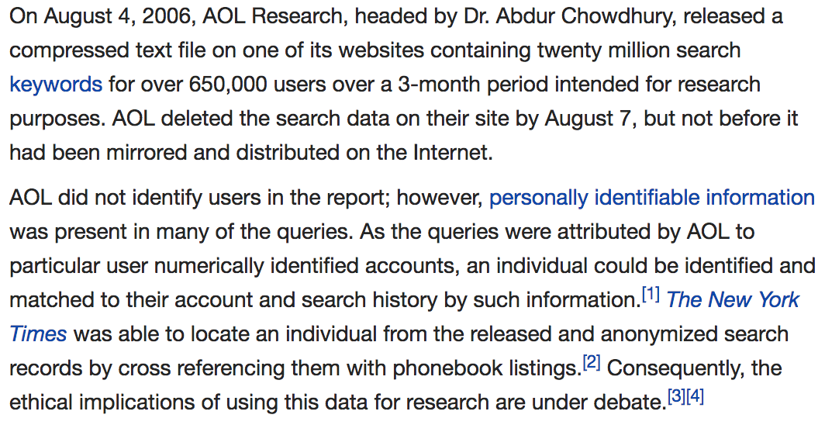
AOL Data Release [NYTimes 2006]

Slide 9
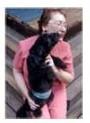
AOL Data Release [NYTimes 2006]
AOL searcher # 4417749
Thelman Arnold, a 62 year old widow who lives in Liburn GA, has three dogs, frequently searches her
friends’ medical ailments.
“landscapers in Lilburn, GA” queries on last name “Arnold” “homes sold in shadow lake subdivision Gwinnett County, GA” “num fingers”
“60 single men”
“dog that urinates on everything”
NYT
Re-identification occurs!

Slide 10
Quasi-identifier (QI)
Removing unique identifiers is not sufficient
QI: maximal set of attributes that could help identify individuals
QI is assumed to be publicly available (e.g., voter registration lists)

Slide 11
k-Anonymity [Sweeney, Samarati 2002]
Each released record should be indistinguishable from at least (k-1) others on its QI attributes
Cardinality of any query result on released data should be at least k

Slide 12
k-Anonymity: Methods
Generalization: replacing (recoding) a value with a less specific but semantically consistent one
Suppression: not releasing any value at all

Slide 13
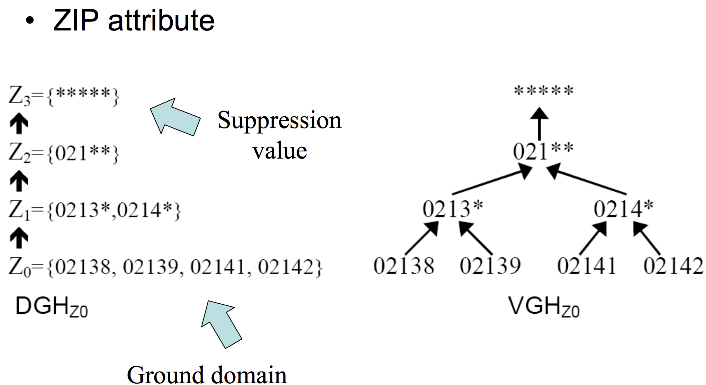
k-Anonymity: Methods

Slide 14
k-Anonymity: Methods
The Microdata
A 3-Anonymous Table
QID |  |  | SA
Zipcode | Age | Gen | Disease
47677 | 29 | F | Ovarian Cancer
47602 | 22 | F | Ovarian Cancer
47678 | 27 | M | Prostate Cancer
47905 | 43 | M | Flu
47909 | 52 | F | Heart Disease
47906 | 47 | M | Heart Disease
QID |  |  | SA
Zipcode | Age | Gen | Disease
476** | 2* | * | Ovarian Cancer
476** | 2* | * | Ovarian Cancer
476** | 2* | * | Prostate Cancer
4790* | [43,52] | * | Flu
4790* | [43,52] | * | Heart Disease
4790* | [43,52] | * | Heart Disease

Slide 15
k-Anonymity: Methods
Finding an optimal anonymization is not easy NP-hard
Heuristic solutions: DataFly, Incognito, Mondrian, TDS, ...
A potential topic for final project: to review, implement and/or compare these algorithms

Slide 16
Attacks Against k-Anonymity
Sensitive values in an equivalence class lack diversity
Homogeneity Attack
Zipcode | Age | Disease
476** | 2* | Heart Disease
476** | 2* | Heart Disease
476** | 2* | Heart Disease
4790* | ≥40 | Flu
4790* | ≥40 | Heart Disease
4790* | ≥40 | Cancer
476** | 3* | Heart Disease
476** | 3* | Cancer
476** | 3* | Cancer
Bob
Zipcode | Age
47678 | 27

Slide 17
ℓ-Diversity [Machanavajjhala et al., 2006]
Let a q*-block be a set of tuples such that its non-sensitive values generalize to q*
A q*-block is ℓ-diverse if contains at least ℓ “well represented” values for the sensitive attribute
A table is ℓ-diverse if every q*-block is ℓ-diverse

Slide 18
Attacks Against ℓ-Diversity
The attacker has background knowledge
Zipcode | Age | Disease
476** | 2* | Heart Disease
476** | 2* | Heart Disease
476** | 2* | Heart Disease
4790* | ≥40 | Flu
4790* | ≥40 | Heart Disease
4790* | ≥40 | Cancer
476** | 3* | Heart Disease
476** | 3* | Cancer
476** | 3* | Cancer
Background Knowledge Attack
Umeko (Japanese)
Zipcode | Age
47673 | 36
knowing that heart attacks occur at a reduced rate in Japanese patients

Slide 19
Distinct ℓ-Diversity:
Each equivalence class has at least ℓ well-represented sensitive values
Probabilistic inference attacks:
In one equivalent class, there are ten tuples.
In the “Disease” area, one of them is “Cancer”, one is “Heart Disease” and the remaining eight are “Flu”.
This satisfies 3-diversity
But the attacker can affirm that the target person’s disease is “Flu” with the accuracy of 80%.

Slide 20
Entropy ℓ-Diversity:
Each equivalence class have enough different sensitive values + the values are distributed evenly enough
It means the entropy of the distribution of sensitive values in each equivalence class is at least log(ℓ)
Too conservative when some values are very common: the entropy of the entire table may be very low

Slide 21
Recursive (c, ℓ)-Diversity:
A compromise definition that ensures the most common value does not appear too often while less common values are ensured to not appear too infrequently
In any q*-block, the most frequent value does not appear too frequently
let r_{i} denote the number of times the i th most frequent sensitive value appears
r₁ < c(r_{ℓ} + r_{ℓ + 1} + ... + r_{m})

Slide 22
Attacks Against ℓ-Diversity
Sensitive values in an equivalence class lack diversity
A 3-diverse patient table
Similarity Attack
Zipcode | Age | Salary | Disease
476** | 2* | 20K | Gastric Ulcer
476** | 2* | 30K | Gastritis
476** | 2* | 40K | Stomach Cancer
4790* | ≥40 | 50K | Gastritis
4790* | ≥40 | 100K | Flu
4790* | ≥40 | 70K | Bronchitis
476** | 3* | 60K | Bronchitis
476** | 3* | 80K | Pneumonia
476** | 3* | 90K | Stomach Cancer
Bob
Zip | Age
47678 | 27
Conclusion
Bob’s salary is in [20k,40k], which is relative low.
Bob has some stomach-related disease.
ℓ-diversity does not consider semantic meanings of sensitive values

Slide 23
t-Closeness [Li et al., 2007]
t-closeness requires that the distribution of a sensitive attribute in any eq. class is close to the distribution of a sensitive attribute in overall table
Privacy is measured by the information gain of an observer
Information Gain = Posterior Belief – Prior Belief

Slide 24
t-Closeness [Li et al., 2007]
In any equivalence class, distance between the distribution of a sensitive attribute in this class and the distribution of the attribute in the whole table is no more than a threshold t.
Given two distributions P = (p₁, p₂, ..., p_{m}), Q = (q₁, q₂, ..., q_{m}), we consider two well-known distance measures.

Slide 25
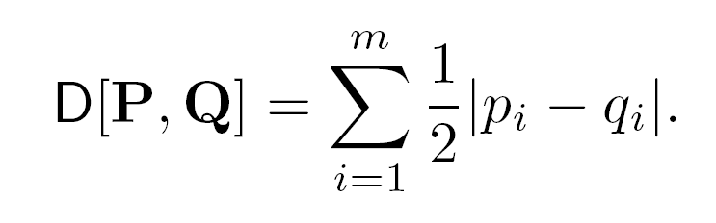
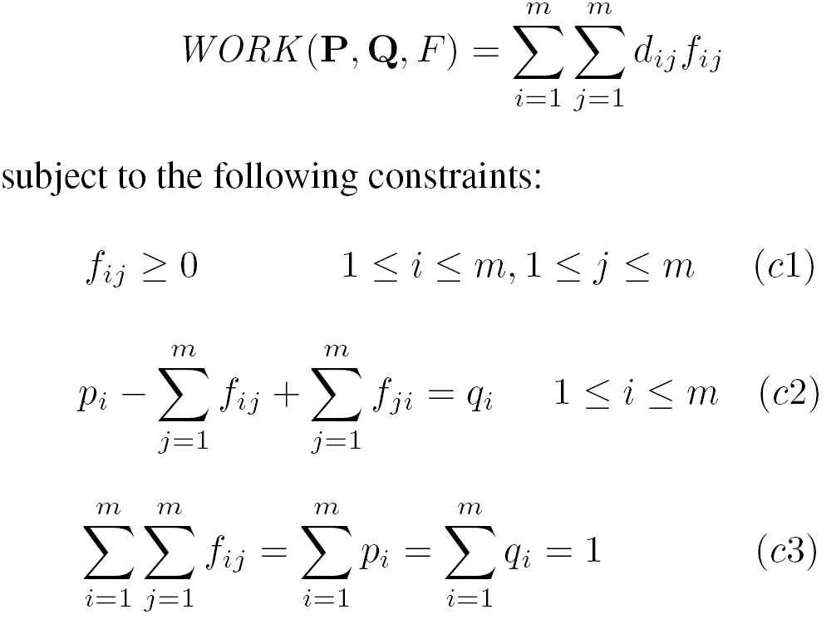
t-Closeness [Li et al., 2007]
Variational Distance:
Earth Mover’s Distance
min

Slide 26
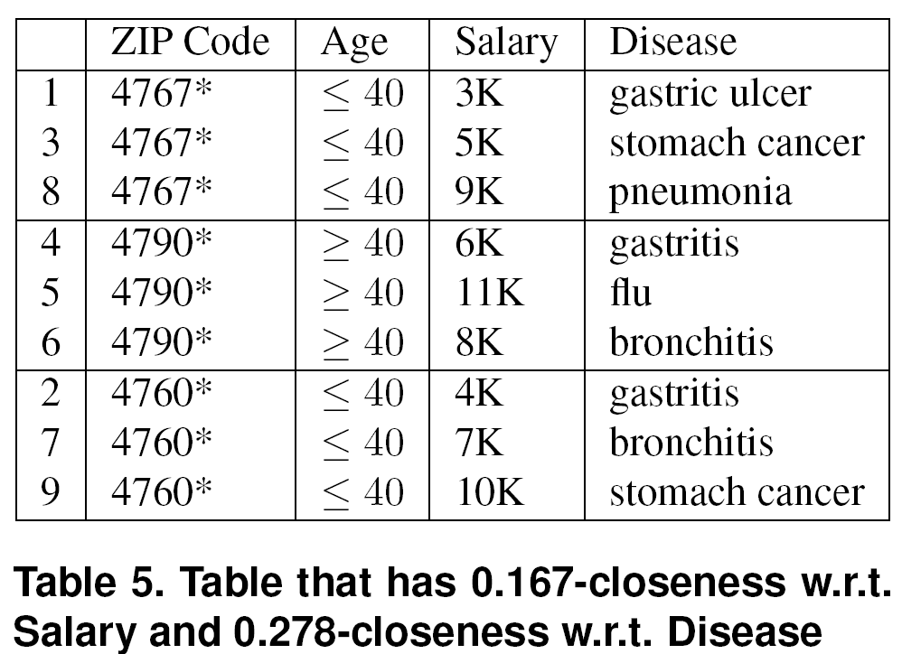
t-Closeness [Li et al., 2007]
t-closeness protects against attribute disclosure but not identity disclosure

Slide 27
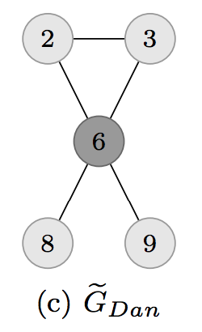
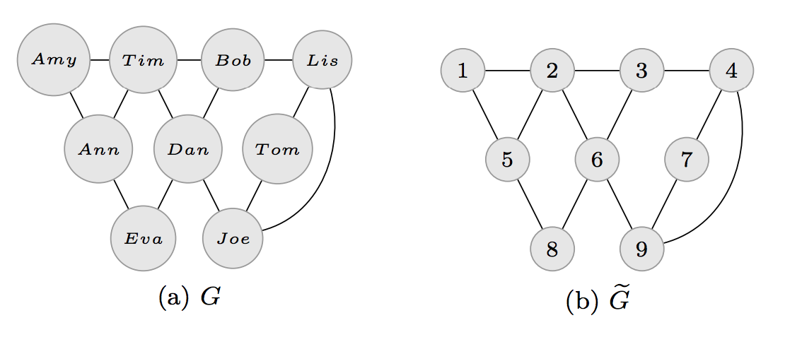
Graph Data?
An attacker knows that Dan has four friends and two of them are friends themselves
Dan re-identified!

Slide 28
Graph Data Anonymization
Identity disclosure and link disclosure
Techniques
Edge and vertex modification (random perturbation)
Grouping vertices and edges into partitions called super-vertices and super-edges

Slide 29
Differential Privacy
The risk to my privacy should not substantially increase as a result of participating in a statistical database.
With or without including me in the database, my privacy risk should not change much

Slide 30
Differential Privacy

Slide 31
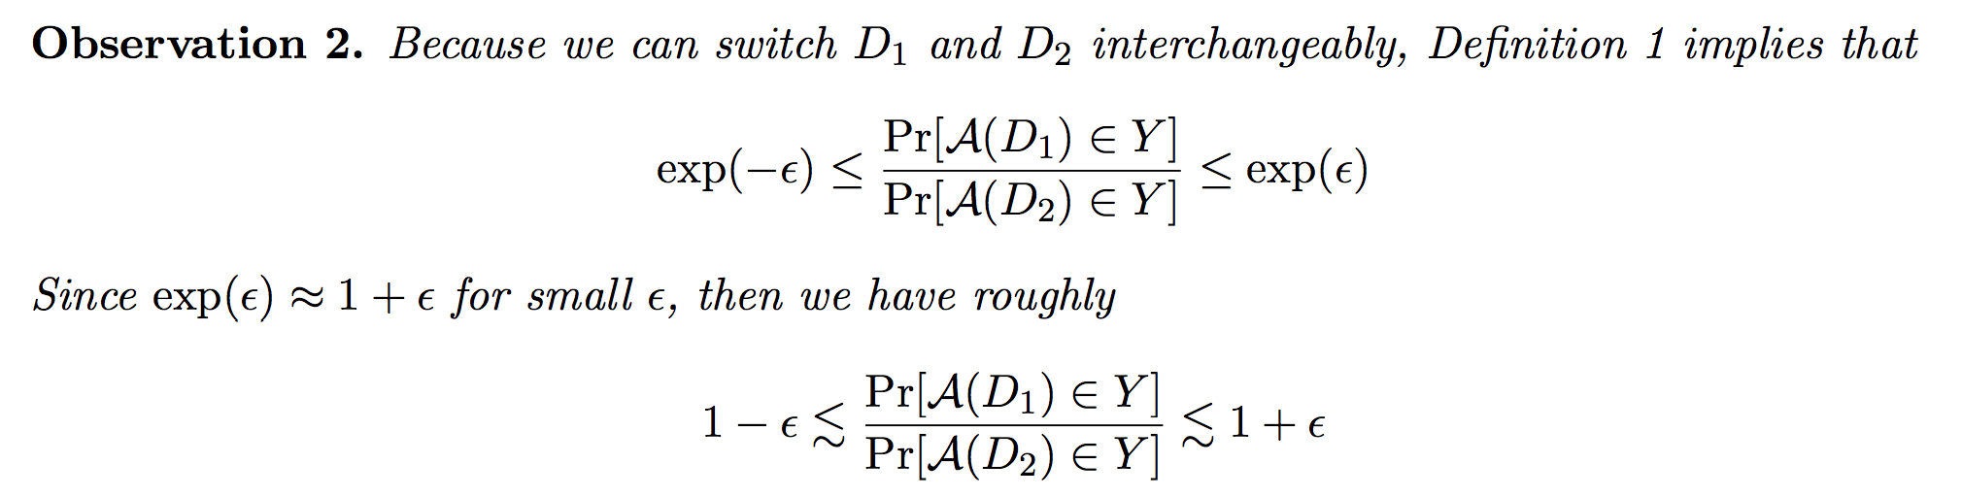
Differential Privacy

Slide 32
Differential Privacy: Methods
We generate noise using the Laplace distribution.
The Laplace distribution, denoted Lap(b), is defined with parameter b and has density function:

Slide 33
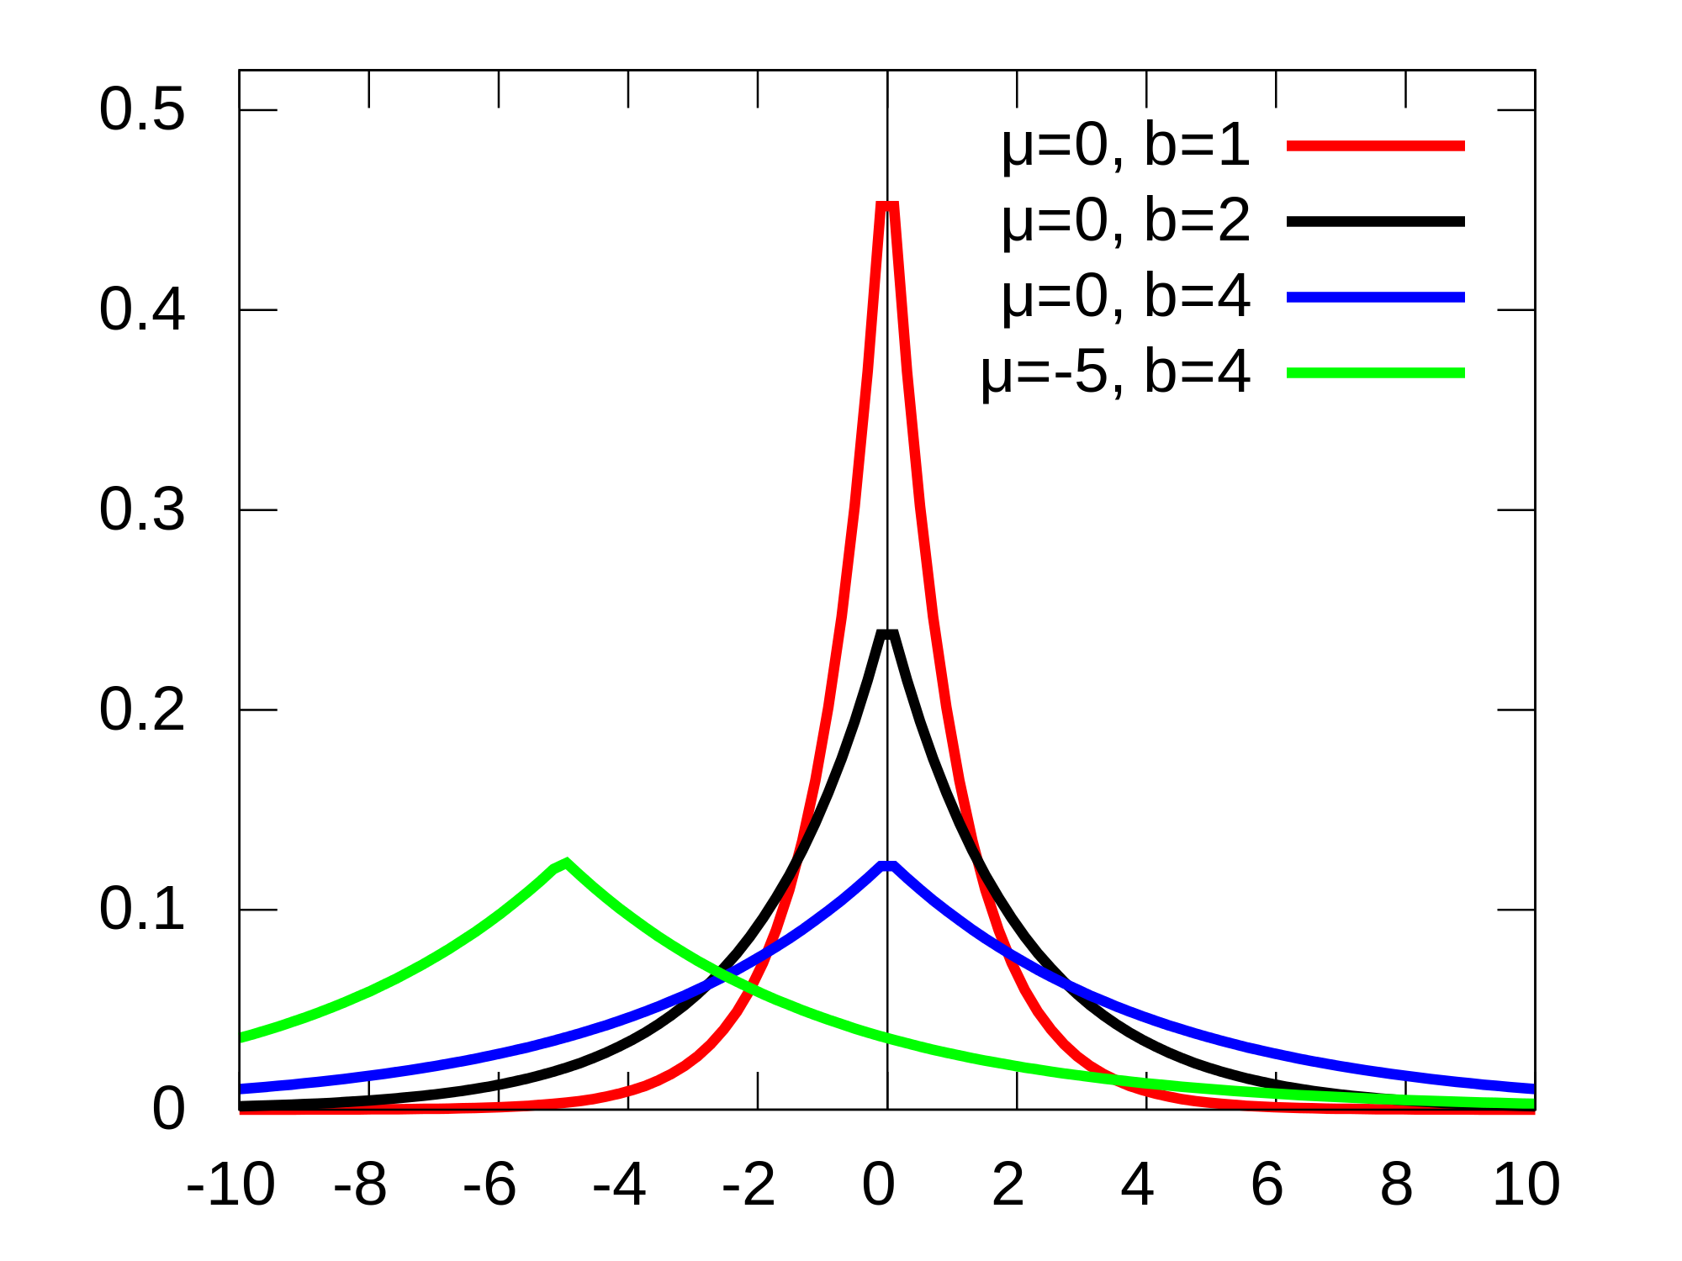
Laplace Distribution

Slide 34
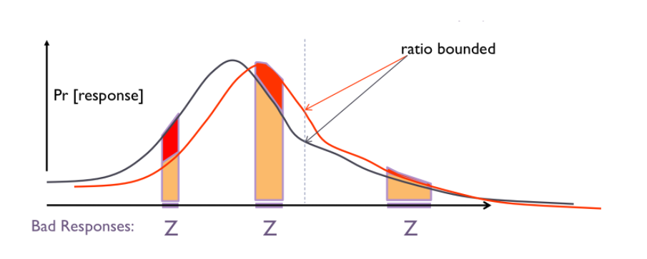
Differential Privacy: Methods

Slide 35
Differential Privacy: Methods
Imagine f as a COUNT-ing query
In this figure, the distribution on the outputs, shown in gray, is centered at the true answer of 100, where Δf = 1 and ε= ln 2. The distribution in orange is the same distribution where the true answer is 101.

Slide 36
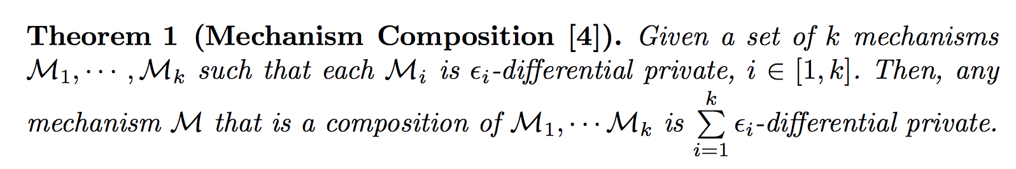
Differential Privacy: Property
Privacy Budget

Slide 37
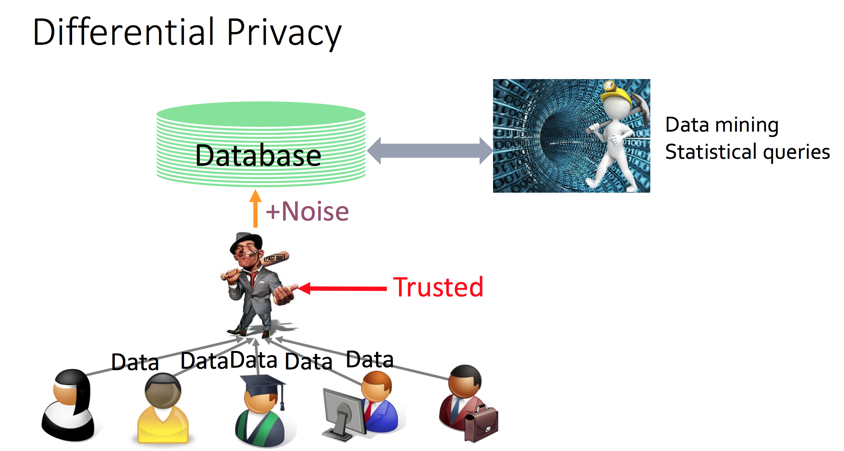
Local Differential Privacy

Slide 38
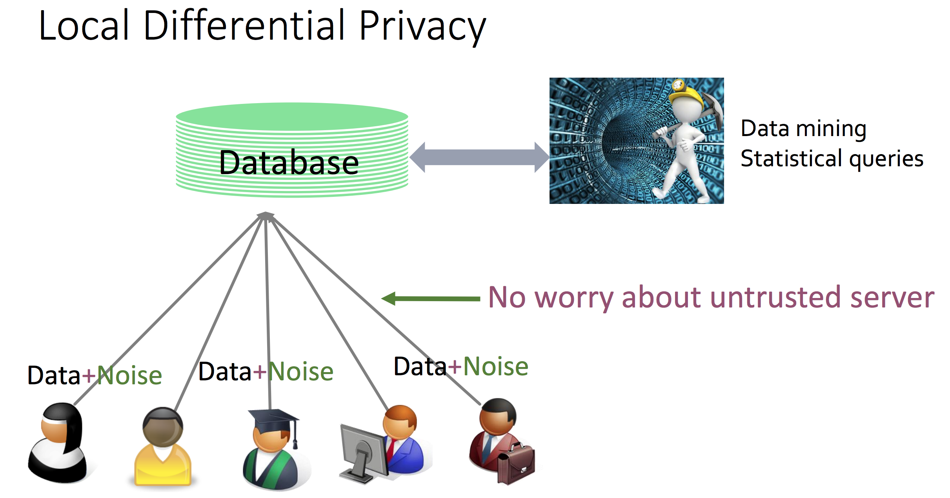
Local Differential Privacy

Slide 39
DP Applications
Differential privacy based on coin tossing is widely deployed!
In Google Chrome browser, to collect browsing statistics
In Apple iOS and MacOS, to collect typing statistics
In Microsoft Windows to collect telemetry data over time
From Snap to perform modeling of user preference
This yields deployments of over 100 million users each

Slide 40
Try out Our Assigment
Python library dp-stats from Rutgers University
DP-Ops: Mean, Variance, Histogram, Principal Component Analysis (PCA), Support Vector Machines (SVM), Logistic Regression
Ref: https://www.ece.rutgers.edu/~hi53/DPSTATS.pdf

